Slide 1
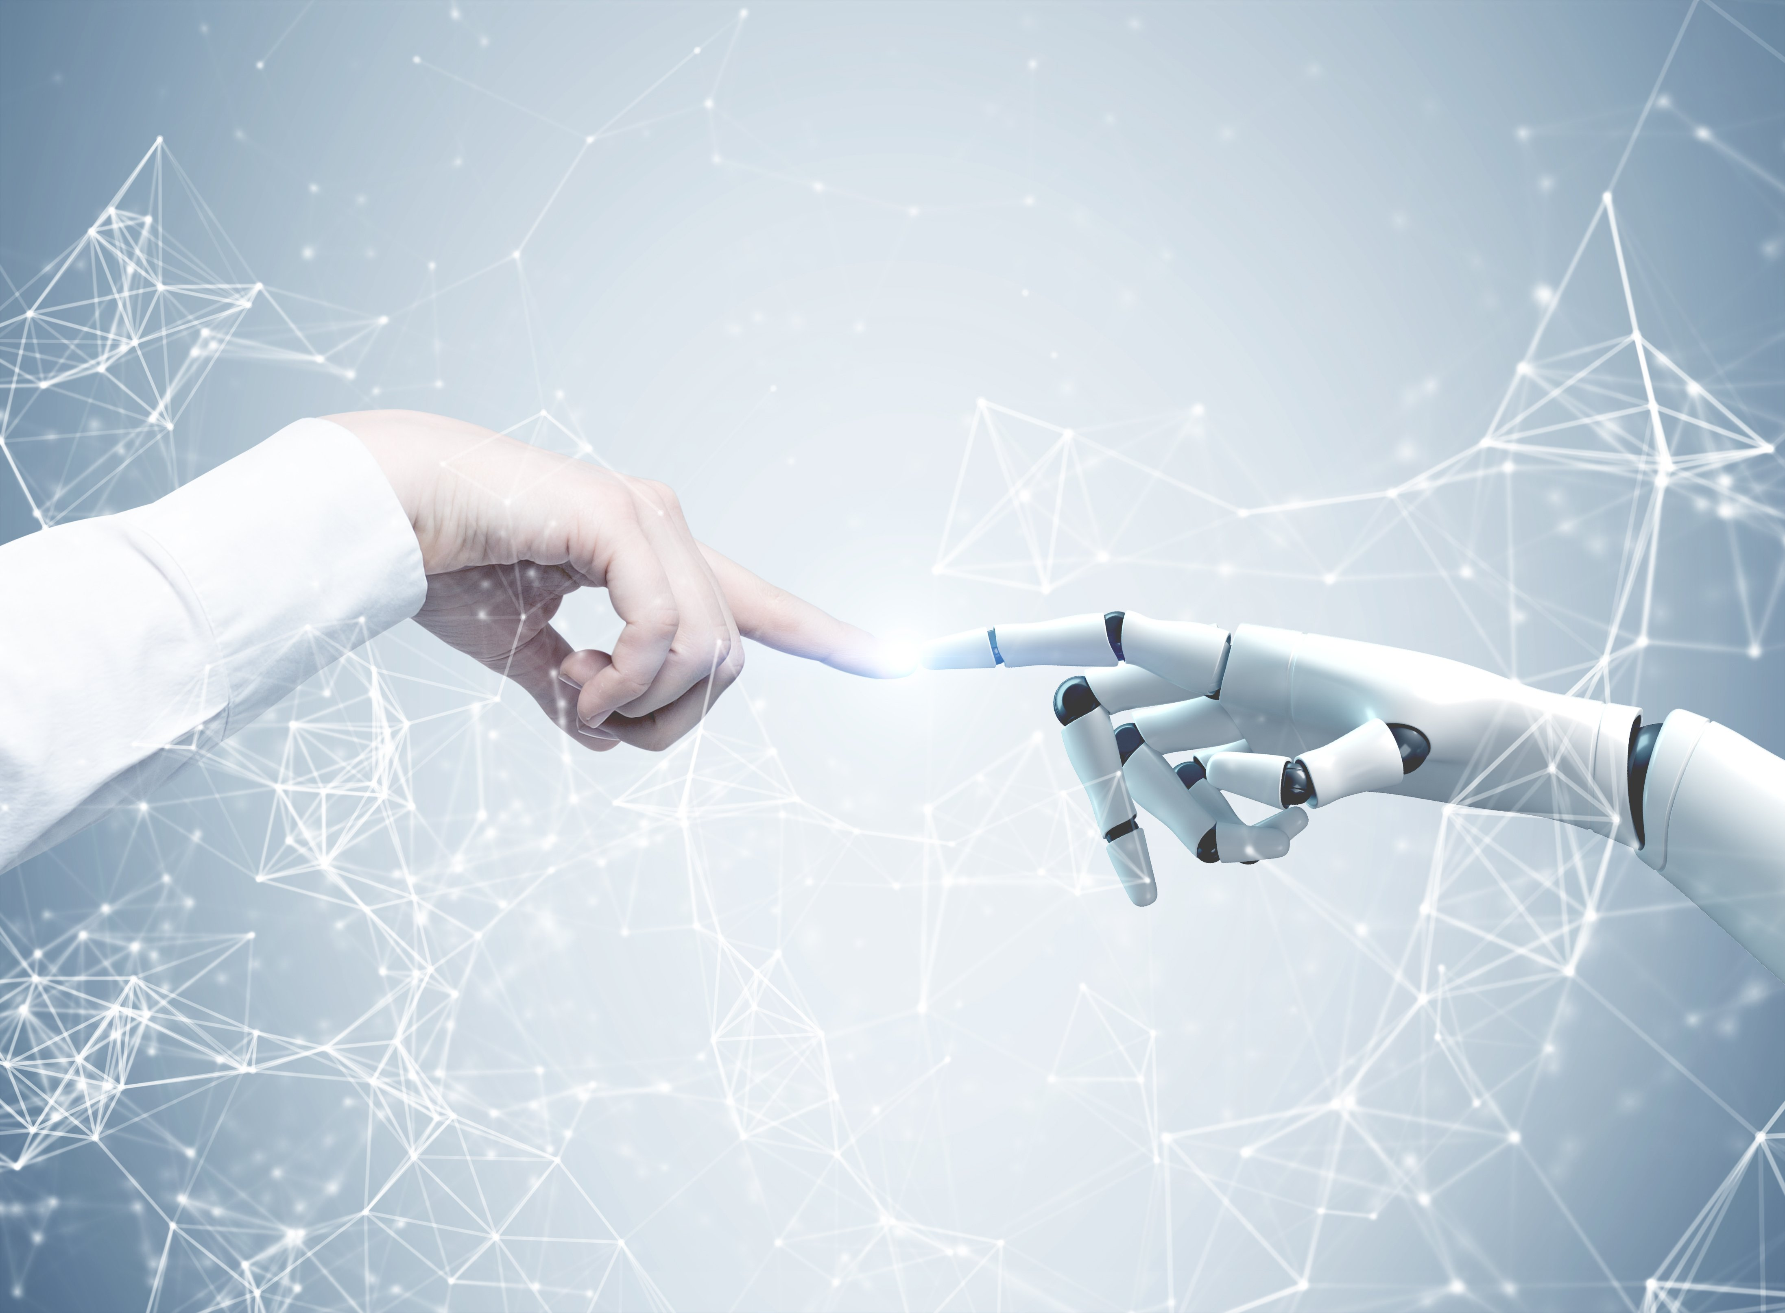
A practical approach of IoRT
Lab of IoT
Presented by
Gerardo Martino
Silvio Di Martino
Computer Science – Internet of Things
Notes:
Good evening everyone, I am Gerardo and today il will present a practical approach of IoRT an architecture able to detect and object in a workspace and by using a robotic arm pick and place that object in a specific location in order to be recognized.

Slide 2
INTRODUCTION
I.
Notes:
Lets start by introducing few concept

Slide 3
Introduction
IoT and Robotics = IoRT
A 6DOF + gripper robotics arm
A smart car equipped with a camera
A warehouse management system with 3 different sorting paths
An architecture supporting interaction between sensing devices and robotics arm
Notes:
- In industrial and automatic sector the integration between IoT and IIoT ha enable what is called IoRT.
- The term IoRT denotes a concept where data from sensors and other sources are merged in order to create an intelligent system, able to perform a specific task.
The aim of the project is to have a 6DOF (degree of freedom) robotic arm, able to peak and place an object in front of the camera and be recognized.
Also a way to control the robotic arm manually through web control panel.
Therefore it is necessary to create an architecture that supports the interaction of all the nodes (robotics arm, detection and localization and object recognition nodes).

Slide 4
HARDWARE
II.

Slide 5
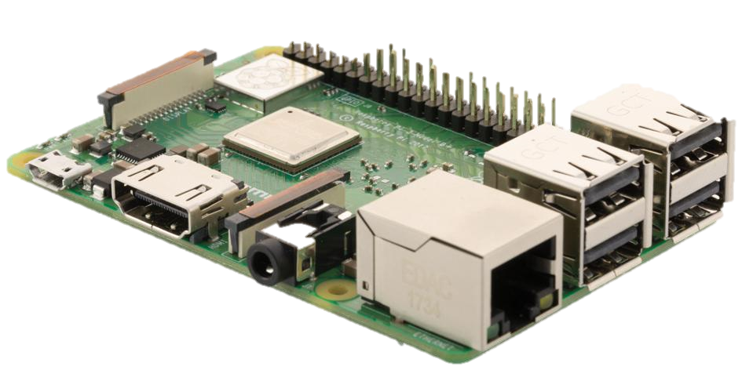
List of Components
01
Raspberry Pi
It’s a small, powerful and cheap computer board. The model used in this project is the 3B with Wi-Fi module integrated on board. Raspbian in the OS in use, and one of the great thigs about the board is that it has a wide range of usage.
Notes:
So, thw main components used in this project are:
The RaspberryPi that is a small computer in this project I used the one integrated with WIFI module, it support most of the I/O peripherals. The OS is Linux base and it Raspbian.
At point two we have 3xMCU ESP32, the module can be easily programmed via Arduino IDE, after installing the EPS32 board in the board manager.
They are particularly used for IoT application because they integrate a WIFI and Bluetooth modules. They operate at 2.4GHz with a date transmission rate about 150Mbps. The board has several digital and analog pins, that help to make great prototype. One of the ESP32 is integrated with camera and it is used to stream and capture the image from the browser.
Il module PWM with 16 output channel is mainly used to control LED and servo motor. For this project it used as a simple external power supply at 6V.
The ultrasound sensor and the PRI motion sensor are used as proximity sense, the first measure the distance between sensor and object the second it is used to sense the movement surrounding the environment.
With These two sensor we can simulate a object detection and localization system.
Finally we have the servo that allow us to move the robotic arm, with rotation range of 0 to 180 degree. It is used mostly for remote control and as joint for the robotic arm.

Slide 6
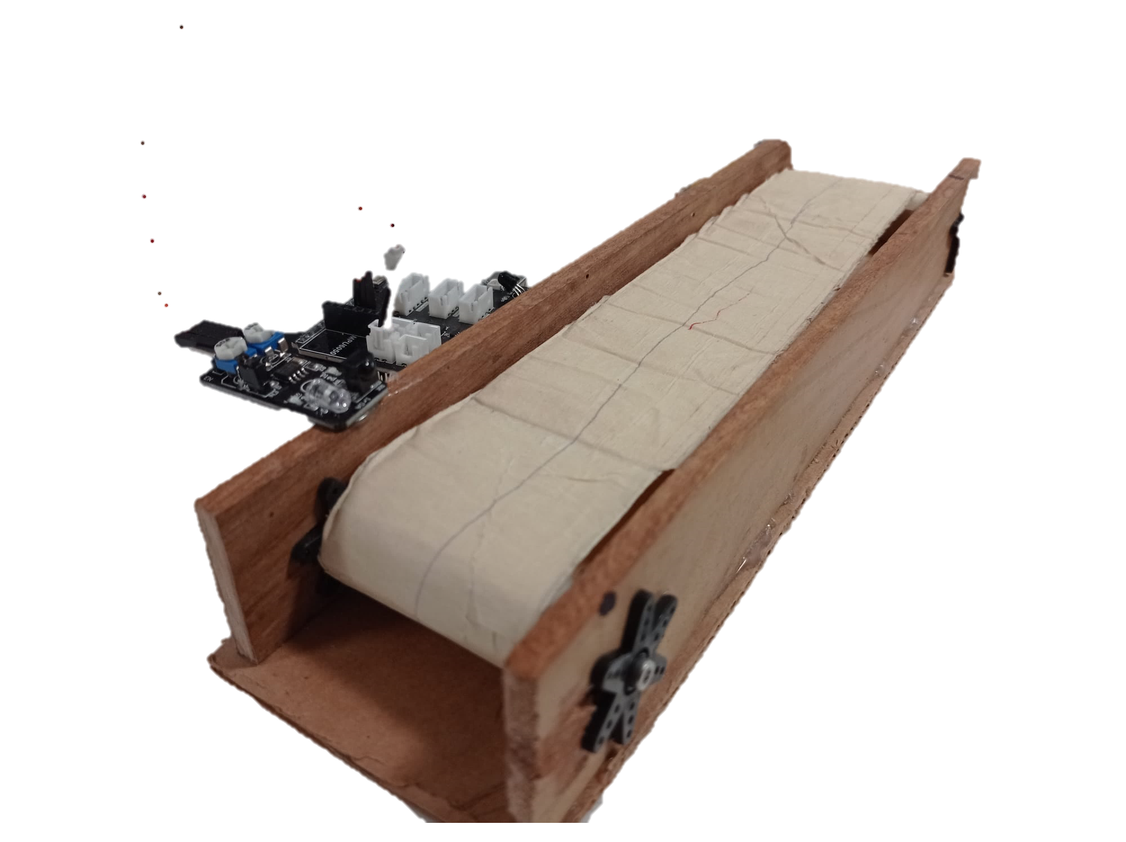
List of Components
02
1x Arduino Rev2
Arduino UNO WiFi Rev.2 is the one-stop-solution for many of the basic IoT application scenarios.
Battery litio
Arduino uno rev2
Robot car kit
03
IR KY-032
It is an infrared sensor used for the detection of obstacles, as it is equipped with an IR emitter and an IR receiver that allow Arduino to signal the presence of objects in the range of this sensor.
04
DC Motor
05
Battery kit
Notes:
So, thw main components used in this project are:
The RaspberryPi that is a small computer in this project I used the one integrated with WIFI module, it support most of the I/O peripherals. The OS is Linux base and it Raspbian.
At point two we have 3xMCU ESP32, the module can be easily programmed via Arduino IDE, after installing the EPS32 board in the board manager.
They are particularly used for IoT application because they integrate a WIFI and Bluetooth modules. They operate at 2.4GHz with a date transmission rate about 150Mbps. The board has several digital and analog pins, that help to make great prototype. One of the ESP32 is integrated with camera and it is used to stream and capture the image from the browser.
Il module PWM with 16 output channel is mainly used to control LED and servo motor. For this project it used as a simple external power supply at 6V.
The ultrasound sensor and the PRI motion sensor are used as proximity sense, the first measure the distance between sensor and object the second it is used to sense the movement surrounding the environment.
With These two sensor we can simulate a object detection and localization system.
Finally we have the servo that allow us to move the robotic arm, with rotation range of 0 to 180 degree. It is used mostly for remote control and as joint for the robotic arm.

Slide 7
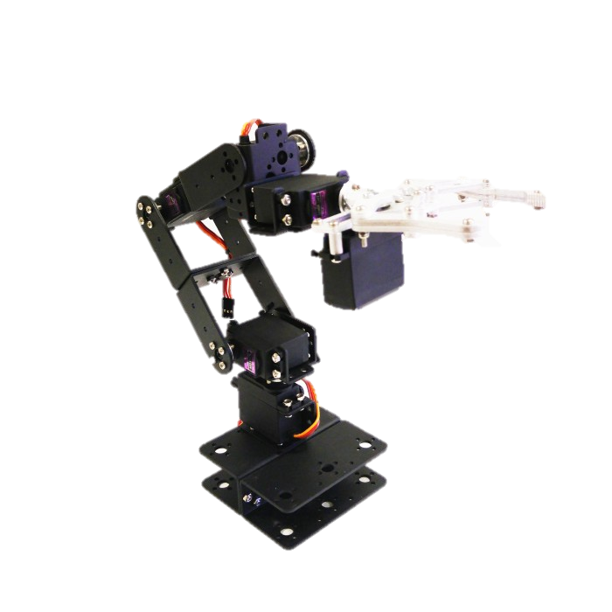
List of Components
06
Robot chassis kit
The robot skeleton.
07
6x Servo MG996R
It is a motor that can be turned to a specified position, from 0 to 180 degree. It is used in remote control (RC) world and also for robotics and automation projects.
08
PCA9685 I2C Control
It is a 16 PWM output channel mainly used to control LEDs, but it can be used also to control servos or as power supply at 6V.
Notes:
So, thw main components used in this project are:
The RaspberryPi that is a small computer in this project I used the one integrated with WIFI module, it support most of the I/O peripherals. The OS is Linux base and it Raspbian.
At point two we have 3xMCU ESP32, the module can be easily programmed via Arduino IDE, after installing the EPS32 board in the board manager.
They are particularly used for IoT application because they integrate a WIFI and Bluetooth modules. They operate at 2.4GHz with a date transmission rate about 150Mbps. The board has several digital and analog pins, that help to make great prototype. One of the ESP32 is integrated with camera and it is used to stream and capture the image from the browser.
Il module PWM with 16 output channel is mainly used to control LED and servo motor. For this project it used as a simple external power supply at 6V.
The ultrasound sensor and the PRI motion sensor are used as proximity sense, the first measure the distance between sensor and object the second it is used to sense the movement surrounding the environment.
With These two sensor we can simulate a object detection and localization system.
Finally we have the servo that allow us to move the robotic arm, with rotation range of 0 to 180 degree. It is used mostly for remote control and as joint for the robotic arm.

Slide 8
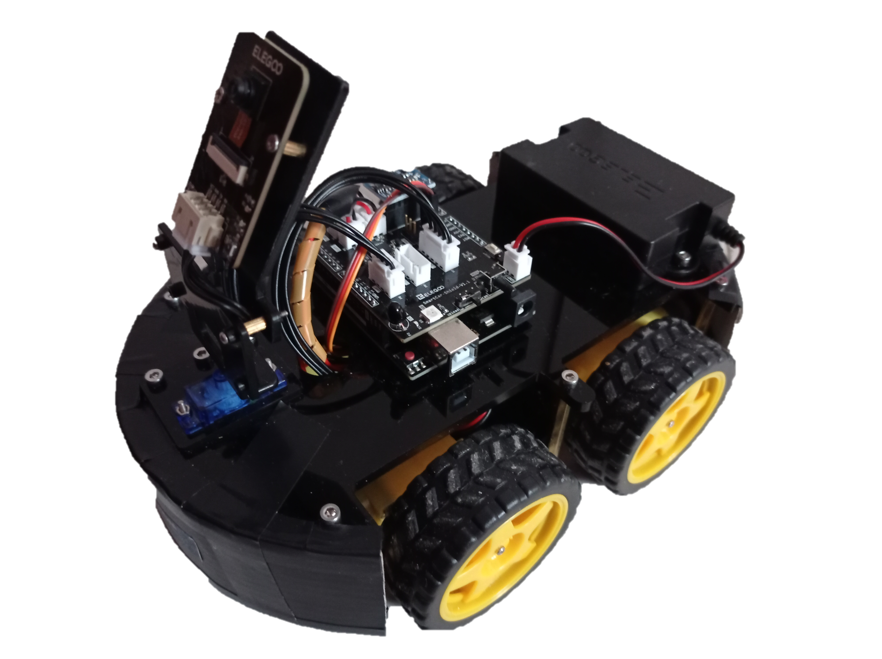
List of Components
09
1x Arduino Rev2
Arduino UNO WiFi Rev.2 is the one-stop-solution for many of the basic IoT application scenarios.
10
1x ESP32 Cam
It is an infrared sensor used for the detection of obstacles, as it is equipped with an IR emitter and an IR receiver that allow Arduino to signal the presence of objects in the range of this sensor.
11
4x DC Motor
12
Car and battery kit
Notes:
So, thw main components used in this project are:
The RaspberryPi that is a small computer in this project I used the one integrated with WIFI module, it support most of the I/O peripherals. The OS is Linux base and it Raspbian.
At point two we have 3xMCU ESP32, the module can be easily programmed via Arduino IDE, after installing the EPS32 board in the board manager.
They are particularly used for IoT application because they integrate a WIFI and Bluetooth modules. They operate at 2.4GHz with a date transmission rate about 150Mbps. The board has several digital and analog pins, that help to make great prototype. One of the ESP32 is integrated with camera and it is used to stream and capture the image from the browser.
Il module PWM with 16 output channel is mainly used to control LED and servo motor. For this project it used as a simple external power supply at 6V.
The ultrasound sensor and the PRI motion sensor are used as proximity sense, the first measure the distance between sensor and object the second it is used to sense the movement surrounding the environment.
With These two sensor we can simulate a object detection and localization system.
Finally we have the servo that allow us to move the robotic arm, with rotation range of 0 to 180 degree. It is used mostly for remote control and as joint for the robotic arm.

Slide 9
List of Components
Battery litio
2xArduino uno rev2
2xSmart car shield
Robot arm kit
Robot car kit
01
Raspberry Pi
04
IR KY-032
It’s a small, powerful and cheap computer board. The model used in this project is the 3B with Wi-Fi module integrated on board. Raspbian in the OS in use, and one of the great thigs about the board is that it has a wide range of usage.
It is an infrared sensor used for the detection of obstacles, as it is equipped with an IR emitter and an IR receiver that allow Arduino to signal the presence of objects in the range of this sensor.
02
05
Servo MG996R
ESP32 CAM
It is a motor that can be turned to a specified position, from 0 to 180 degree. It is used in remote control (RC) world and also for robotics and automation projects.
ESP32 is used for a variety of IoT applications, because of the WiFi and BLE module integrated. The WiFi protocol operates at 2.4 GHz with a data rate up to 150 Mbps. It is a MCU with multiple digital and analog I/O pins to connect sensing or actuation devices.
03
PCA9685 I2C Control
06
DC Motor
It is a 16 PWM output channel mainly used to control LEDs, but it can be used also to control servos or as power supply at 6V.
It is a motor that combined with the wheels lets the car move.
Notes:
So, thw main components used in this project are:
The RaspberryPi that is a small computer in this project I used the one integrated with WIFI module, it support most of the I/O peripherals. The OS is Linux base and it Raspbian.
At point two we have 3xMCU ESP32, the module can be easily programmed via Arduino IDE, after installing the EPS32 board in the board manager.
They are particularly used for IoT application because they integrate a WIFI and Bluetooth modules. They operate at 2.4GHz with a date transmission rate about 150Mbps. The board has several digital and analog pins, that help to make great prototype. One of the ESP32 is integrated with camera and it is used to stream and capture the image from the browser.
Il module PWM with 16 output channel is mainly used to control LED and servo motor. For this project it used as a simple external power supply at 6V.
The ultrasound sensor and the PRI motion sensor are used as proximity sense, the first measure the distance between sensor and object the second it is used to sense the movement surrounding the environment.
With These two sensor we can simulate a object detection and localization system.
Finally we have the servo that allow us to move the robotic arm, with rotation range of 0 to 180 degree. It is used mostly for remote control and as joint for the robotic arm.

Slide 10
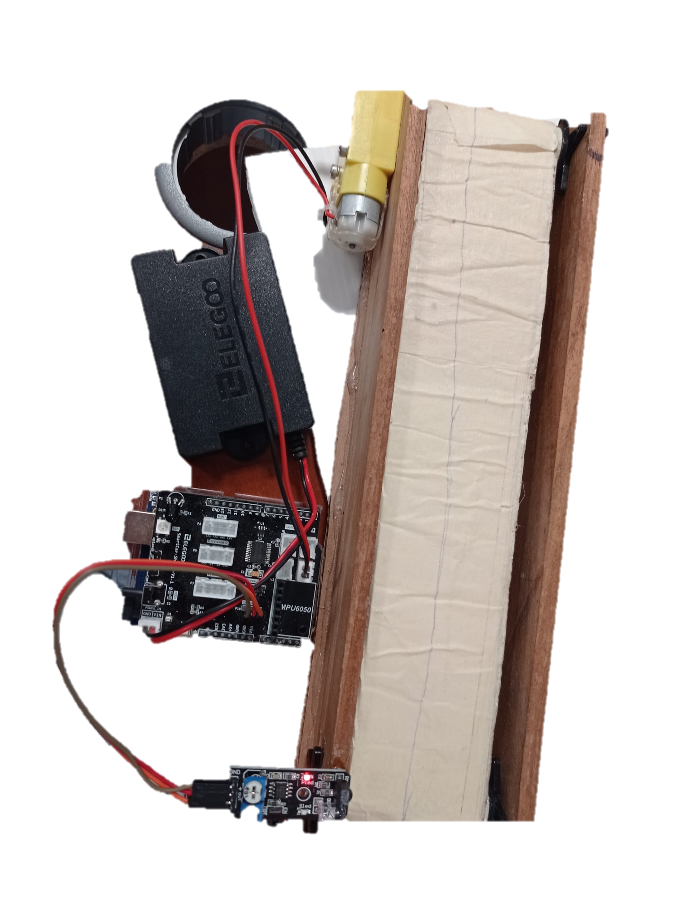
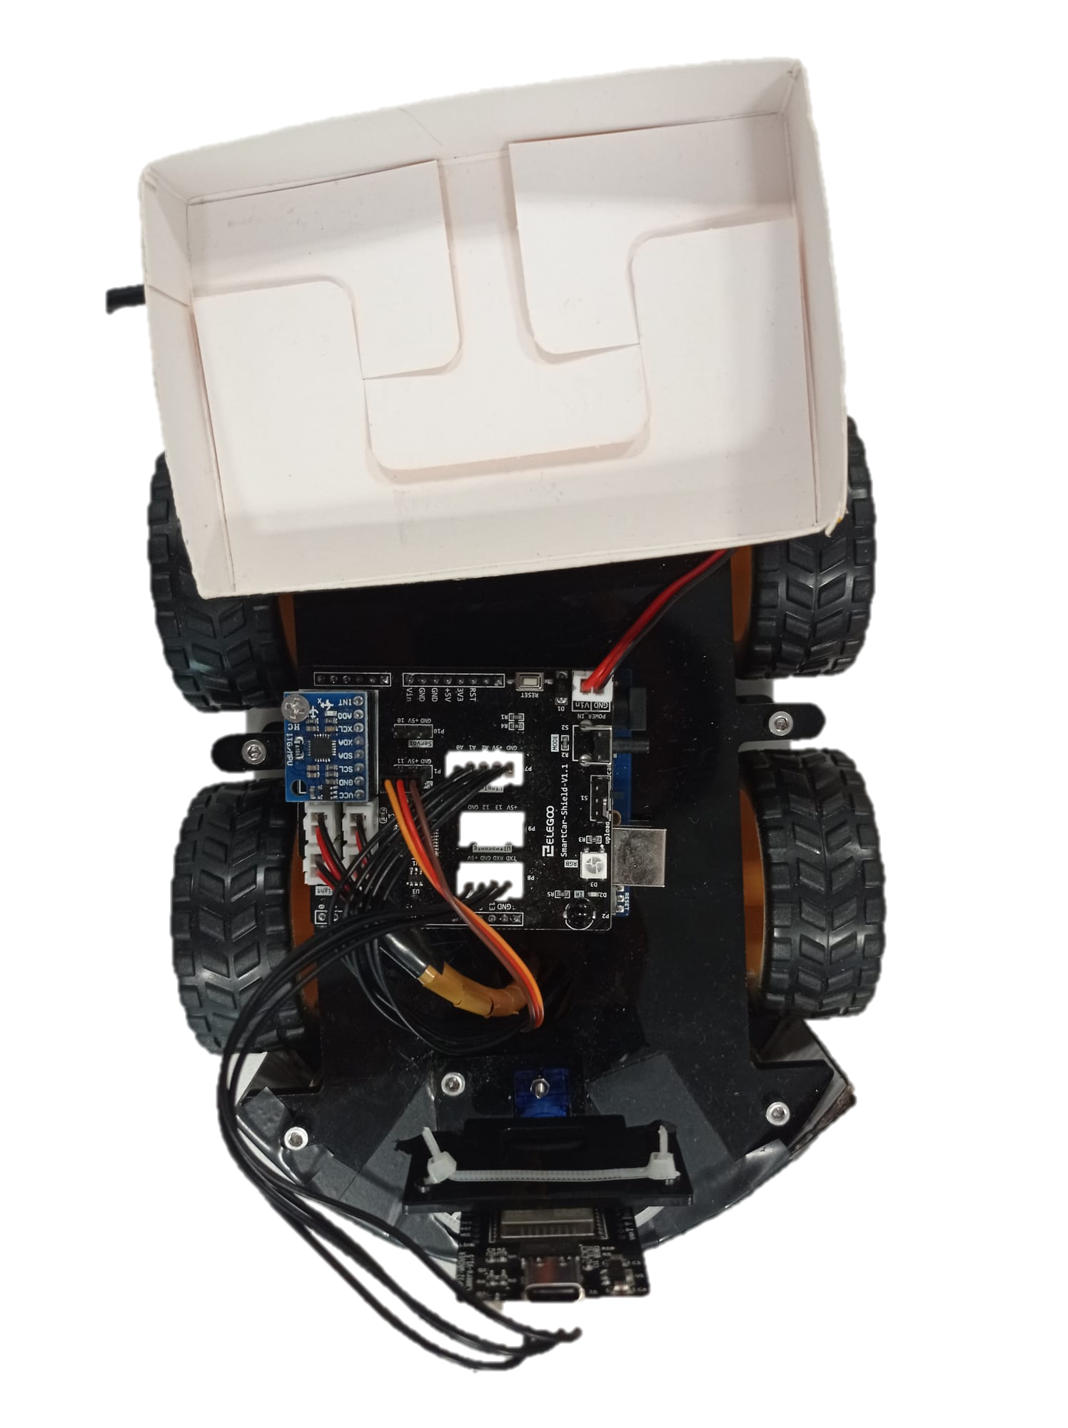
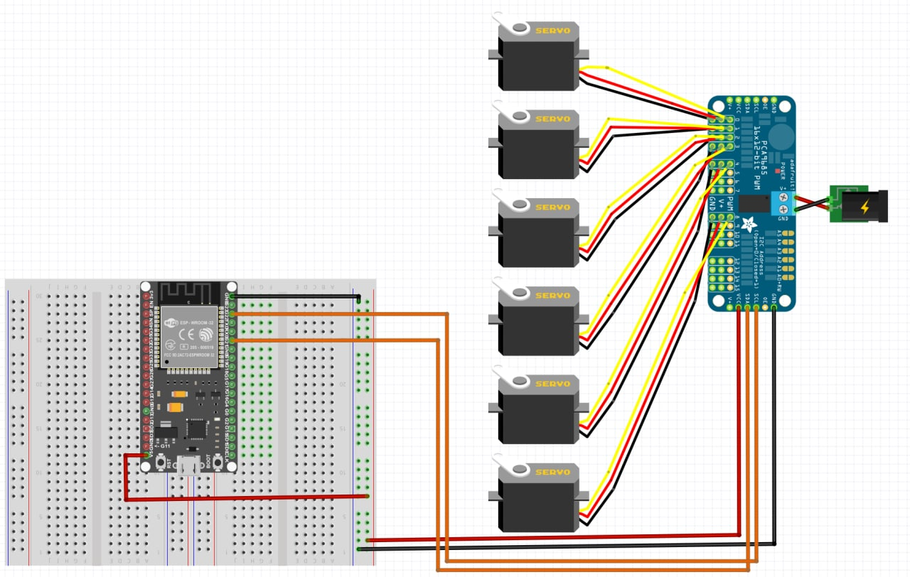
Hardware Connection
Conveyor belt
Robot Arm Node
Smart car
Servo motor 4 - Gripper
Notes:
Robot arm with three Degree of Freedom (3-DOF) with gripper
Four servo motors that represent the joints to enable the movement of the robotic arm
It produce a 180-degree rotation with a torque of 13 kg/cm and a turning rate at 0.14s/60 degree

Slide 11
ARCHITECTURE
III.

Slide 12
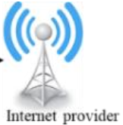
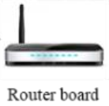

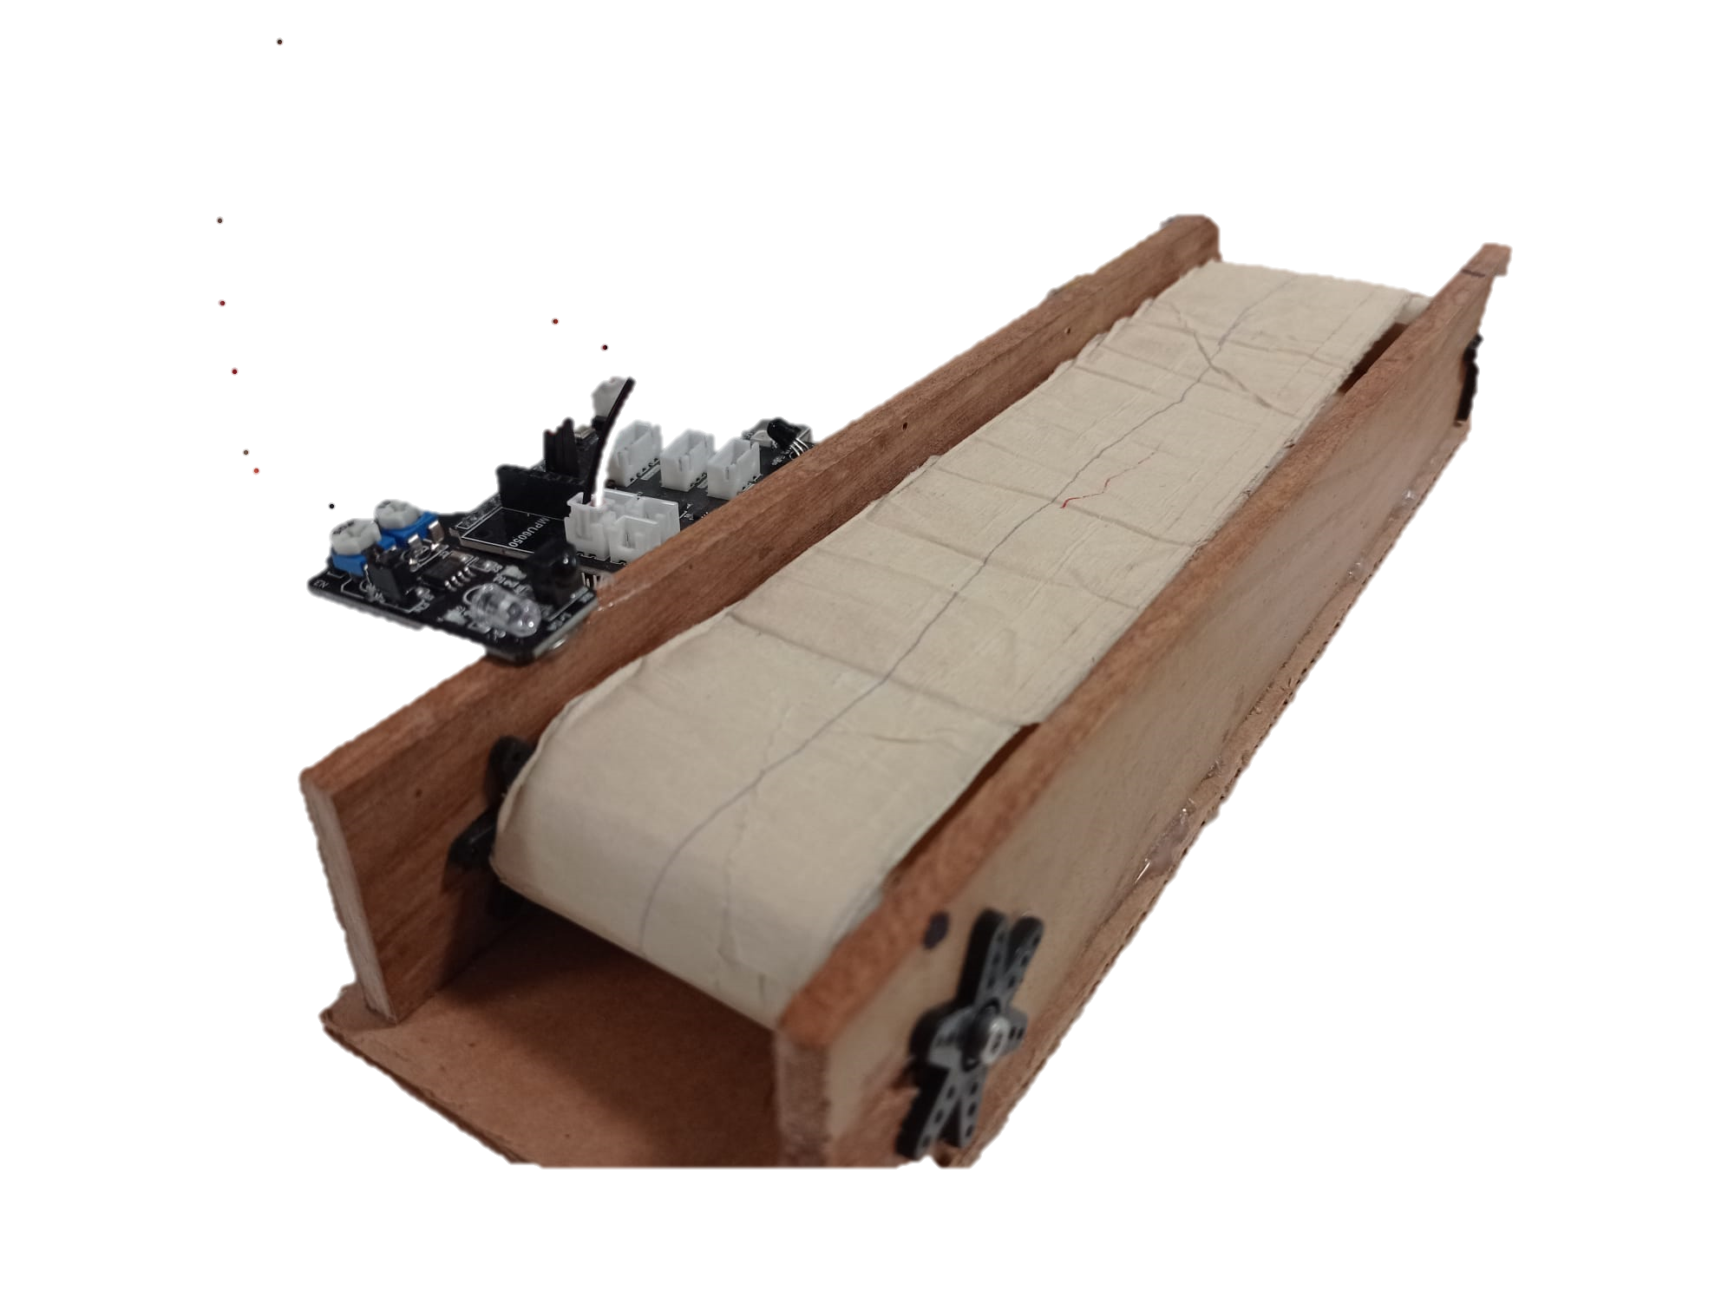

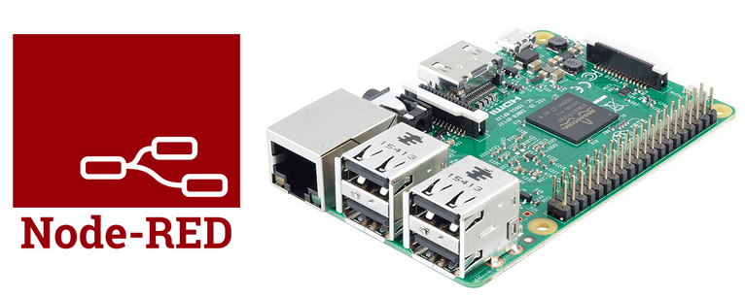

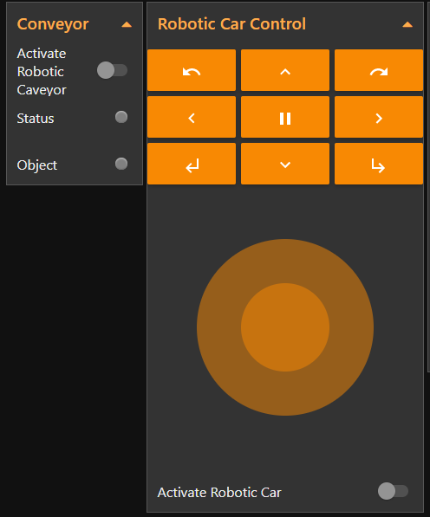
Architecture
Router & Internet
Conveyor belt
NodeRed & MQTT broker
Subscribe
Publish
Operator
Dashboard
Robot Arm Node
Topics
robotics/wristPitchArm
robotics/wristRollArm
Subscribe
robotics/baseArm
robotics/shoulderArm
Publish
robotics/elbowArm
robotics/gripperArm
arm/controller
arm/conveyor
Smart car
arm/car
car/control
car/camera
car/parameters
Subscribe
Publish
Notes:
The architecture idealized take advantage of the local WiFi network, all the node must be properly configured to communicate each other and so that the MQTT message can be exchanged.
we have different node connected each other
we have the Robot arm node
than the camera node
thatn the detection node
the dashboard and operator
Then all the topics pass thorough the broker that manage messages of the different nodes.
The raspberryPi so is a mqtt broker and host of NodeRED system, which as we said is a flow-based graphical programming tool. where we have the control panel that control remotely the robotic arm and other panel to
stream the object through the camera and see where is positioned

Slide 13
SOFTWARE
IV.

Slide 14
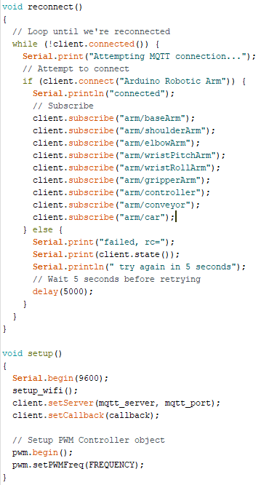
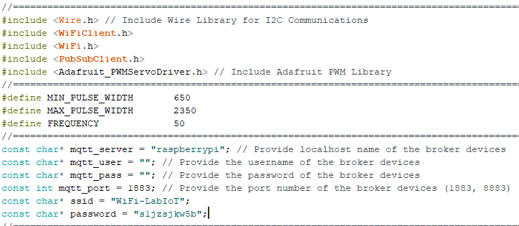
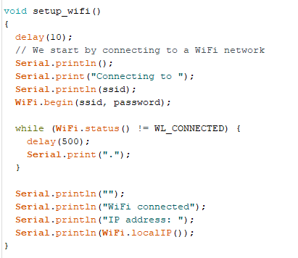
WiFi & MQTT Connection – Robotic Arm
Notes:
This is the code used to connect all the nodes in use in this architecture to the wifi and mqtt connection, so the camera node will connect to the wifi with predefined paramentes,

Slide 15
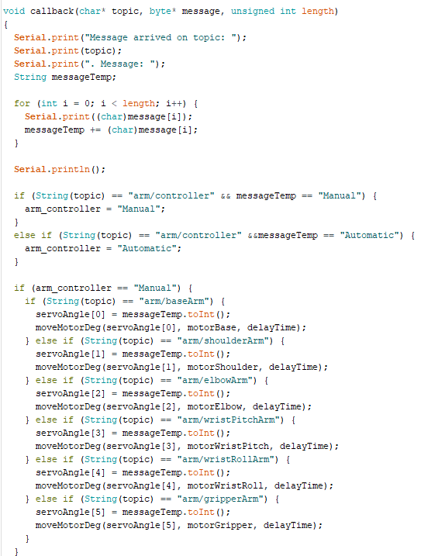
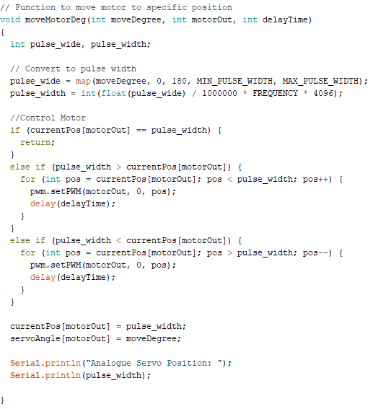
Movement - Robotic Arm
MQTT Callback
Movement
Notes:
then the detection nodes after the inizialization it will enter in loop(),
when the movement is detected,
the servo will rotates from o to 180 degree,
and calculate thought the utrasound the distance between the object and sensor and where is located thorugh the position.
Finally we publish a message to the broker.

Slide 16
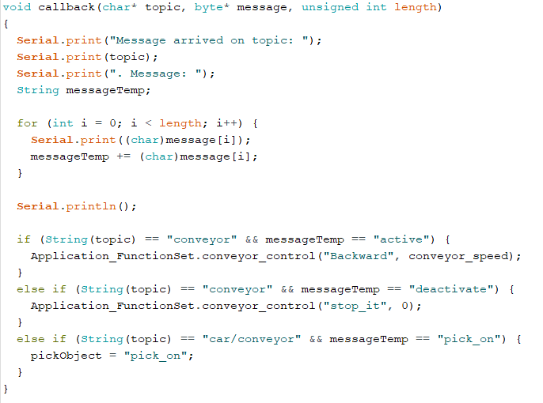
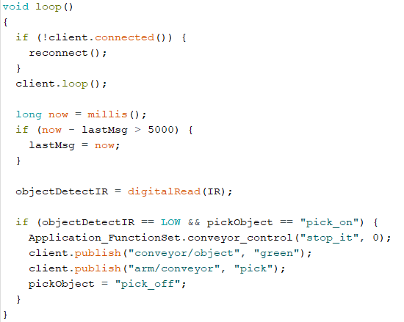
Conveyor belt
MQTT callback
Object detection & MQTT communication
Notes:
then the detection nodes after the inizialization it will enter in loop(),
when the movement is detected,
the servo will rotates from o to 180 degree,
and calculate thought the utrasound the distance between the object and sensor and where is located thorugh the position.
Finally we publish a message to the broker.

Slide 17
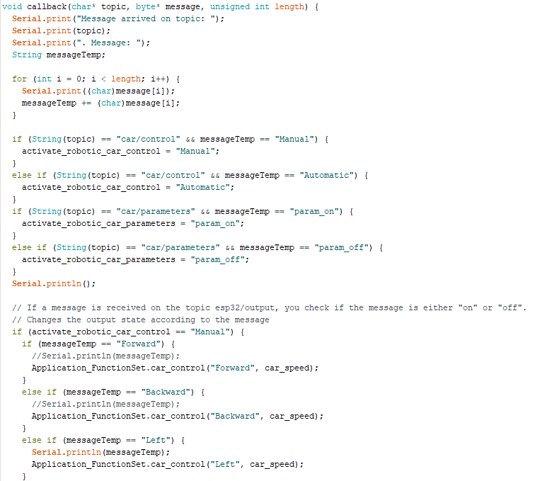
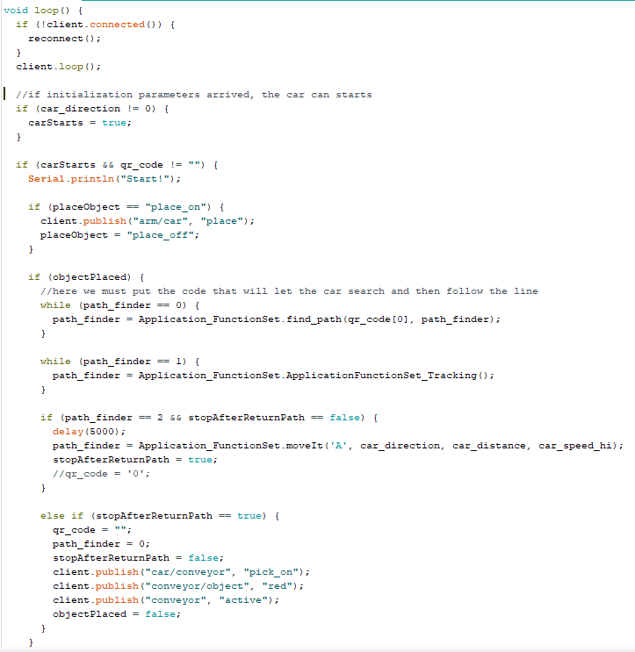
Movement – Smart car
MQTT Callback
Movement
Notes:
then the detection nodes after the inizialization it will enter in loop(),
when the movement is detected,
the servo will rotates from o to 180 degree,
and calculate thought the utrasound the distance between the object and sensor and where is located thorugh the position.
Finally we publish a message to the broker.

Slide 18
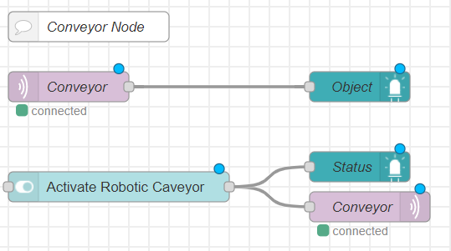
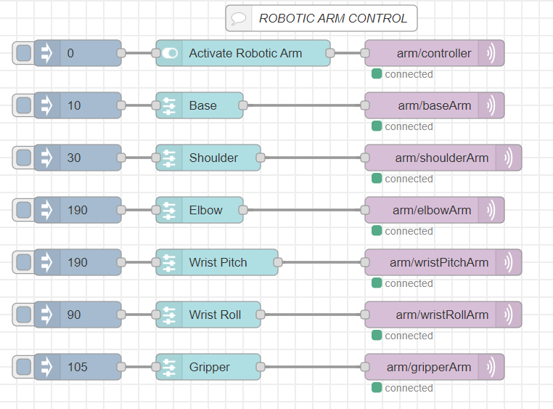
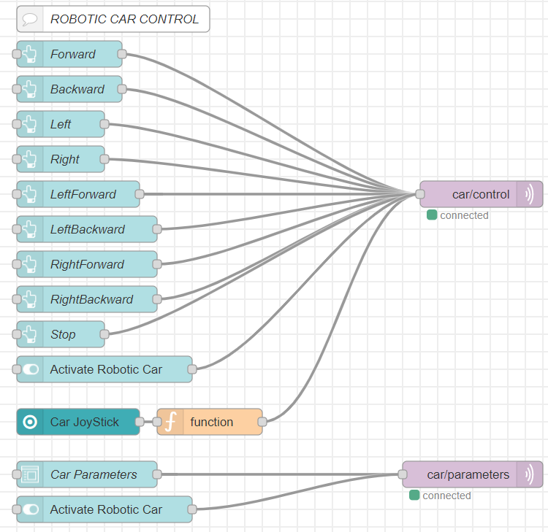
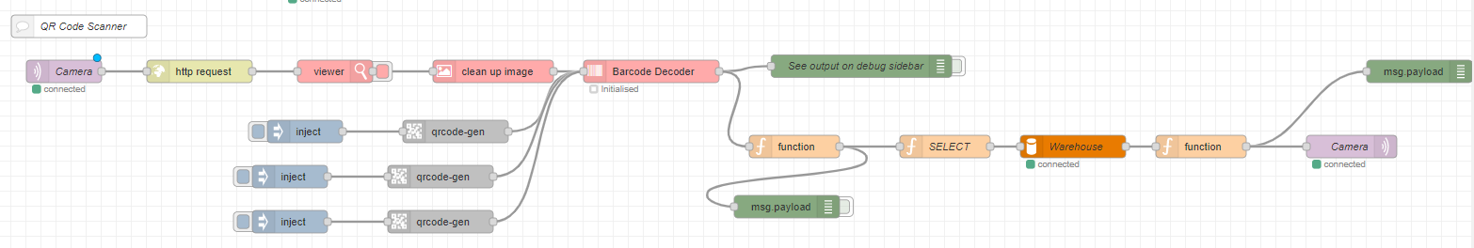
NodeRED
Notes:
A flow-based programming tool, used to describe the purpose of each node created
It provides a browser based flow editor that makes the interconnection between nodes easy and extensible with other palette
The web page is designed to control the angle of rotation of each servomotors of the robotic arm using a control panel.
It is possible to switch from manually to automatic control.
In manual mode we can use all the slider widgets to control the robot remotely.
Publish/Subscribe mechanism is used in order to control the arm in real-time
A flow for object recognition
here we have the flow user to control the robot, to manage the detection and localization of the object and the camera
- as we can see we have three different flow with different block used to design the robot control panel
- so we can switch from manual to automatci mode
- we can use the slider widget to control the robot
- we have another flow that create the pannel to check where to pick the object
- so al this block are connectect with pub/sub mechanism in order that we can transfer message from one devide to another

Slide 19
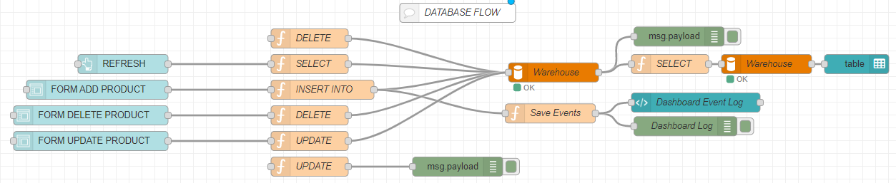
NodeRED
Notes:
A flow-based programming tool, used to describe the purpose of each node created
It provides a browser based flow editor that makes the interconnection between nodes easy and extensible with other palette
The web page is designed to control the angle of rotation of each servomotors of the robotic arm using a control panel.
It is possible to switch from manually to automatic control.
In manual mode we can use all the slider widgets to control the robot remotely.
Publish/Subscribe mechanism is used in order to control the arm in real-time
A flow for object recognition
here we have the flow user to control the robot, to manage the detection and localization of the object and the camera
- as we can see we have three different flow with different block used to design the robot control panel
- so we can switch from manual to automatci mode
- we can use the slider widget to control the robot
- we have another flow that create the pannel to check where to pick the object
- so al this block are connectect with pub/sub mechanism in order that we can transfer message from one devide to another

Slide 20

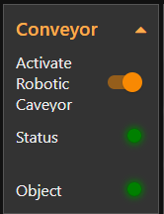
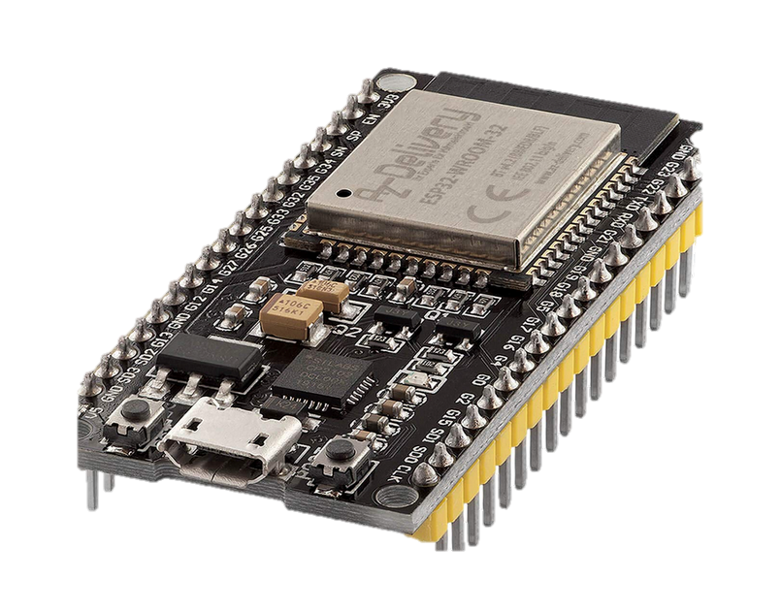
Node-RED + MQTT
Dashboard
Robot Arm Node
conveyor “active”
arm/camera “take”
arm/conveyor “pick”
http request
Smart car
Conveyor belt
Notes:
Finally In this slide we see more in deteail how practically the messages are generated and interchanged and managed by the broker
how it comunicate with nodered
how nodeRED comunicate with the camera anche the other node.

Slide 21
Node-RED + MQTT
Dashboard
Robot Arm Node
arm/car “car_on”
arm/car “place”
arm/car “place”
Smart car
Conveyor belt
Notes:
Finally In this slide we see more in deteail how practically the messages are generated and interchanged and managed by the broker
how it comunicate with nodered
how nodeRED comunicate with the camera anche the other node.

Slide 22
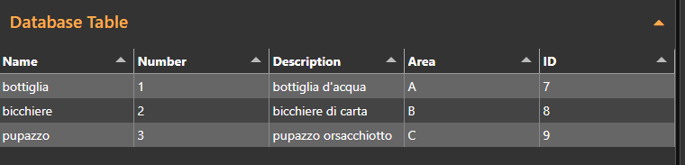
Node-RED + MQTT
Dashboard
Robot Arm Node
conveyor “active”
car/object “the_qr_code”
Smart car
Conveyor belt
Notes:
Finally In this slide we see more in deteail how practically the messages are generated and interchanged and managed by the broker
how it comunicate with nodered
how nodeRED comunicate with the camera anche the other node.

Slide 23
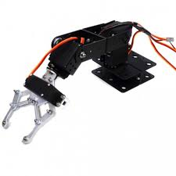
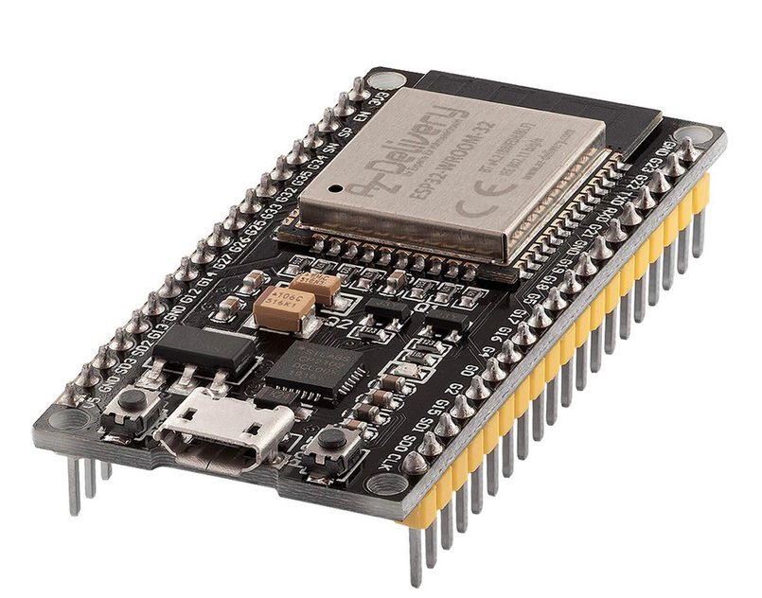
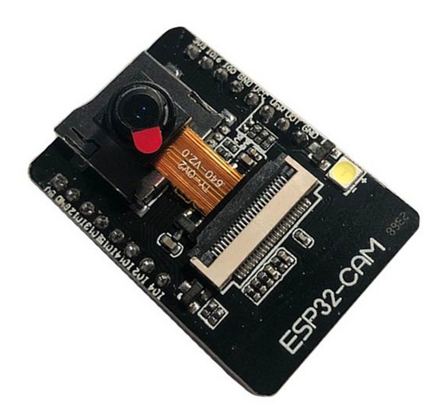
Publish in:
-arm/conveyor “pick”
- robotics/baseArm
- robotics/shoulderArm
- robotics/elbowArm
- robotics/gripperArm
- robotics/controller
- robotics/autoPickPlace
Node-RED + MQTT
Dashboard
Publish in:
- robotics/baseArm
- robotics/shoulderArm
- robotics/elbowArm
- robotics/gripperArm
- robotics/controller
- robotics/autoPickPlace
Robot Arm Node
Publish in:
-conveyor “active”
Publish in:
- camera/capture
Publish in:
- camera/capture
Subscribe in:
- robotics/baseArm
- robotics/shoulderArm
- robotics/elbowArm
- robotics/gripperArm
- robotics/controller
- robotics/autoPickPlace
Subscribe In:
- radar/conveyor
HTTP Request/Response
Camera Node
Conveyor belt
Notes:
Finally In this slide we see more in deteail how practically the messages are generated and interchanged and managed by the broker
how it comunicate with nodered
how nodeRED comunicate with the camera anche the other node.

Slide 24
DEMO
V.

Slide 25
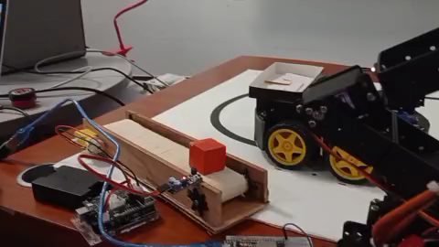
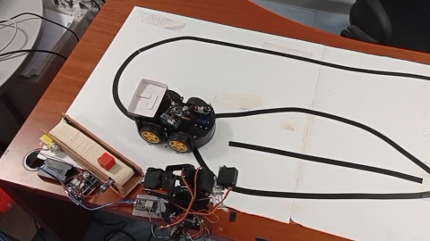
Demo

Slide 26
Conclusions
Integrate a qr scanner to add products in the warehouse database
Upgrade the camera with a more professional one.
Upgrade the robotic arm with a professional one.
Integrate the robotic arm with a camera to track the package
Add a delivery mechanism like a drone

Slide 27
THANK YOU
Presented by
Gerardo Martino
Computer Science – Internet of Things

